Slide 1
Introduction to Web
Amuthan Arulraj

Slide 2
Understanding How a Web Application Works
GOALS
Learning HTML, CSS & Javascript
Designing & Developing Complex Web Applications
Learning Recent Developments in Web Development

Slide 3
How does the internet work?

Slide 4
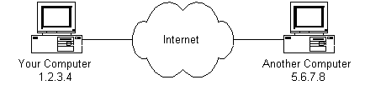

Slide 5
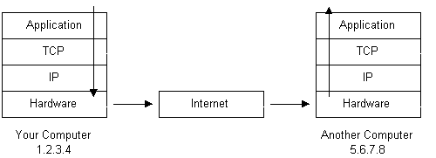
Notes:
The message would start at the top of the protocol stack on your computer and work it's way downward.
If the message to be sent is long, each stack layer that the message passes through may break the message up into smaller chunks of data. This is because data sent over the Internet (and most computer networks) are sent in manageable chunks. On the Internet, these chunks of data are known as packets.
The packets would go through the Application Layer and continue to the TCP layer. Each packet is assigned a port number. Ports will be explained later, but suffice to say that many programs may be using the TCP/IP stack and sending messages. We need to know which program on the destination computer needs to receive the message because it will be listening on a specific port.
After going through the TCP layer, the packets proceed to the IP layer. This is where each packet receives it's destination address, 5.6.7.8.
Now that our message packets have a port number and an IP address, they are ready to be sent over the Internet. The hardware layer takes care of turning our packets containing the alphabetic text of our message into electronic signals and transmitting them over the phone line.
On the other end of the phone line your ISP has a direct connection to the Internet. The ISPs routerexamines the destination address in each packet and determines where to send it. Often, the packet's next stop is another router. More on routers and Internet infrastructure later.
Eventually, the packets reach computer 5.6.7.8. Here, the packets start at the bottom of the destination computer's TCP/IP stack and work upwards.
As the packets go upwards through the stack, all routing data that the sending computer's stack added (such as IP address and port number) is stripped from the packets.
When the data reaches the top of the stack, the packets have been re-assembled into their original form, "Hello computer 5.6.7.8!"
Many applications are running concurrently over the Web, such as web browsing/surfing, e-mail, file transfer, audio & video streaming, and so on. In order for proper communication to take place between the client and the server, these applications must agree on a specific application-level protocol such as HTTP, FTP, SMTP, POP, and etc.

Slide 6
HTTP
HyperText Transfer Protocol

Slide 7
“
“The Hypertext Transfer Protocol (HTTP) is an application-level protocol for distributed, collaborative, hypermedia information systems. It is a generic, stateless, protocol which can be used for many tasks beyond its use for hypertext, such as name servers and distributed object management systems, through extension of its request methods, error codes and headers.”

Slide 8
An HTTP client sends a request message to an HTTP server. The server, in turn, returns a response message. In other words, HTTP is a pull protocol, the client pulls information from the server (instead of server pushes information down to the client).
HTTP is a stateless protocol. Current request does not know what has been done in the previous requests.
HTTP permits negotiating of data type and representation, so as to allow systems to be built independently of the data being transferred.
Notes:
Whenever you issue a URL from your browser to get a web resource using HTTP, e.g. http://www.nowhere123.com/index.html, the browser turns the URL into a request message and sends it to the HTTP server. The HTTP server interprets the request message, and returns you an appropriate response message, which is either the resource you requested or an error message.

Slide 9
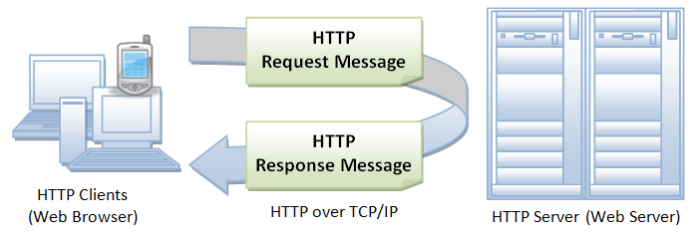

Slide 10
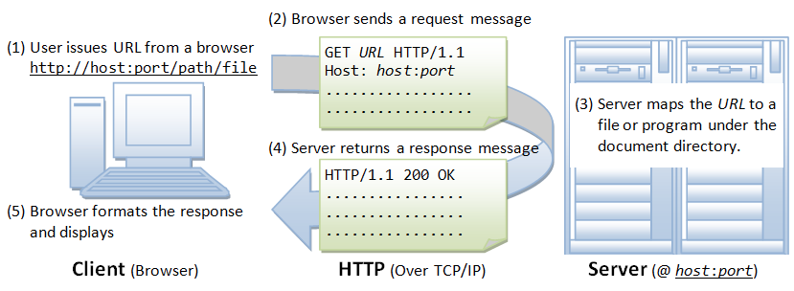

Slide 11
Sample Request
GET /index.html HTTP/1.1 Host: www.northeastern.edu Accept: image/gif, image/jpeg, */* Accept-Language: en-us Accept-Encoding: gzip, deflate User-Agent: Mozilla/4.0 (compatible; MSIE 6.0; Windows NT 5.1) (blank line)
Notes:
When this request message reaches the server, the server can take either one of these actions:
The server interprets the request received, maps the request into a file under the server's document directory, and returns the file requested to the client.
The server interprets the request received, maps the request into a program kept in the server, executes the program, and returns the output of the program to the client.
The request cannot be satisfied, the server returns an error message.

Slide 12
Sample Response
HTTP/1.1 200 OK Date: Sun, 18 Oct 2009 08:56:53 GMT Server: Apache/2.2.14 (Win32) Last-Modified: Sat, 20 Nov 2004 07:16:26 GMT ETag: "10000000565a5-2c-3e94b66c2e680" Accept-Ranges: bytes Content-Length: 44 Connection: close Content-Type: text/html X-Pad: avoid browser bug <html><body><h1>Welcome to Northeastern</h1></body></html>
Notes:
The browser receives the response message, interprets the message and displays the contents of the message on the browser's window according to the media type of the response (as in the Content-Type response header). Common media type include "text/plain", "text/html", "image/gif", "image/jpeg", "audio/mpeg", "video/mpeg", "application/msword", and "application/pdf".
In its idling state, an HTTP server does nothing but listening to the IP address(es) and port(s) specified in the configuration for incoming request. When a request arrives, the server analyzes the message header, applies rules specified in the configuration, and takes the appropriate action. The webmaster's main control over the action of web server is via the configuration, which will be dealt with in greater details in the later sections.

Slide 13
URL: Uniform Resource Locator
Used to uniquely identify a resource over the web. URL has the following syntax: protocol://hostname:port/path-and-file-name
There are 4 parts in a URL:
Protocol
Hostname
Port
Path-and-file-name
Notes:
Protocol: The application-level protocol used by the client and server, e.g., HTTP, FTP, and telnet. Hostname: The DNS domain name (e.g., www.nowhere123.com) or IP address (e.g., 192.128.1.2) of the server. Port: The TCP port number that the server is listening for incoming requests from the clients. Path-and-file-name: The name and location of the requested resource, under the server document base directory.

Slide 14
URI: Uniform Resource Identifier
URI is more general than URL, which can even locate a fragment within a resource. The URI syntax for HTTP protocol is: http://host:port/path?request-parameters#nameAnchor
The request parameters, in the form of name=value pairs, are separated from the URL by a '?'. The name=value pairs are separated by a '&'.
The #nameAnchor identifies a fragment within the HTML document, defined via the anchor tag <a name="anchorName">...</a>.
URL rewriting for session management, e.g., "...;sessionID=xxxxxx".

Slide 15
Request Methods
GET: A client can use the GET request to get a web resource from the server. POST: Used to post data up to the web server. PUT: Ask the server to store the data. DELETE: Ask the server to delete the data. TRACE: Ask the server to return a diagnostic trace of the actions it takes. OPTIONS: Ask the server to return the list of request methods it supports.

Slide 16
Response Status Code
The first line of the response message contains the response status code, The status code is a 3-digit number: 1xx (Informational): Request received, server is continuing the process. 2xx (Success): The request was successfully received, understood, accepted and serviced. 3xx (Redirection): Further action must be taken in order to complete the request. 4xx (Client Error): The request contains bad syntax or cannot be understood. 5xx (Server Error): The server failed to fulfill an apparently valid request.
Notes:
Status code is generated by the server to indicate the outcome of the request.

Slide 17
Common Status Codes
200 OK: The request is fulfilled. 302 Found & Redirect (or Move Temporarily): Same as 301, but the new location is temporarily in nature. The client should issue a new request, but applications need not update the references. 400 Bad Request: Server could not interpret or understand the request, probably syntax error in the request message. 401 Authentication Required: The requested resource is protected, and require client’s credential (username/password). The client should re-submit the request with his credential (username/password). 403 Forbidden: Server refuses to supply the resource, regardless of identity of client. 404 Not Found: The requested resource cannot be found in the server. 405 Method Not Allowed: The request method used, e.g., POST, PUT, DELETE, is a valid method. However, the server does not allow that method for the resource requested. 408 Request Timeout: 414 Request URI too Large: 500 Internal Server Error: Server is confused, often caused by an error in the server-side program responding to the request. 501 Method Not Implemented: The request method used is invalid (could be caused by a typing error, e.g., "GET" misspell as "Get").

Slide 18
Request Headers
Host: domain-name - HTTP/1.1 supports virtual hosts. Accept: mime-type-1, mime-type-2, ... - The client can use the Accept header to tell the server the MIME types it can handle and it prefers.
Accept-Language: language-1, language-2, ... - The client can use the Accept-Language header to tell the server what languages it can handle or it prefers. Accept-Charset: Charset-1, Charset-2, ... - For character set negotiation, the client can use this header to tell the server which character sets it can handle or it prefers. Examples of character sets are ISO-8859-1, ISO-8859-2, ISO-8859-5, BIG5, UCS2, UCS4, UTF8.
Notes:
Multiple DNS names (e.g., www.nowhere123.com and www.nowhere456.com) can reside on the same physical server, with their own document root directories. Host header is mandatory in HTTP/1.1 to select one of the hosts.
The following headers can be used for content negotiation by the client to ask the server to deliver the preferred type of the document (in terms of the media type, e.g. JPEG vs. GIF, or language used e.g. English vs. French) if the server maintain multiple versions for the same document.
If the server has multiple versions of the document requested (e.g., an image in GIF and PNG, or a document in TXT and PDF), it can check this header to decide which version to deliver to the client. (E.g., PNG is more advanced more GIF, but not all browser supports PNG.) This process is called content-type negotiation.
If the server has multiple versions of the requested document (e.g., in English, Chinese, French), it can check this header to decide which version to return. This process is called language negotiation.

Slide 19
Request Headers
Accept-Encoding: encoding-method-1, encoding-method-2, ... - The client can use this header to tell the server the type of encoding it supports. Connection: Close|Keep-Alive - The client can use this header to tell the server whether to close the connection after this request, or to keep the connection alive for another request.
User-Agent: browser-type - Identify the type of browser used to make the request. Server can use this information to return different document depending on the type of browsers. Content-Length: number-of-bytes - Used by POST request, to inform the server the length of the request body. Content-Type: mime-type - Used by POST request, to inform the server the media type of the request body. Cookie: cookie-name-1=cookie-value-1, cookie-name-2=cookie-value-2, ... - The client uses this header to return the cookie(s) back to the server, which was set by this server earlier for state management.
Notes:
If the server has encoded (or compressed) version of the document requested, it can return an encoded version supported by the client. The server can also choose to encode the document before returning to the client to reduce the transmission time. The server must set the response header "Content-Encoding" to inform the client that the returned document is encoded. The common encoding methods are "x-gzip (.gz, .tgz)" and "x-compress (.Z)".
HTTP/1.1 uses persistent (keep-alive) connection by default. HTTP/1.0 closes the connection by default.

Slide 20
Response Headers
Connection: Close|Keep-Alive - Specifies whether the connection to the server is open or closed. Content-Length: number-of-bytes - The length in bytes of the body in the response. Content-Type: mime-type - The MIME type of the content. For example, Content-Type: text/html; charset=utf-8 Server: The name of the server that created the response.
Date: The date and time server responded, for example, Wed, 01 Mar 2006 12:00:00 GMT.
Set-Cookie: HTTP response header is used to send cookies from the server to the user agent.

Slide 21
Common Document Types

Slide 22
HTML Document
<!DOCTYPE html> <html> <body> <h1>My First Heading</h1> <p>My first paragraph.</p> </body> </html>

Slide 23
XML Document
<person> <firstname>Quincy</firstname> <lastname>Adams</lastname> <location>Boston</location> </person>

Slide 24
JSON Data
{ “firstname”: "Quincy", “lastname”: "Adams",
“location”: “Boston” }

Slide 25
Browsers

Slide 26
“
“A web browser (commonly referred to as a browser) is a software application for retrieving, presenting and traversing information resources on the World Wide Web. An information resource is identified by a Uniform Resource Identifier (URI/URL) that may be a web page, image, video or other piece of content. Hyperlinks present in resources enable users easily to navigate their browsers to related resources.”

Slide 27
Popular Browsers
Google Chrome
Mozilla Firefox
Microsoft Edge/IE
Safari
Opera
Mobile browser versions of above
Notes:
Talk about brower engines

Slide 28
References
https://web.stanford.edu/class/msande91si/www-spr04/readings/week1/InternetWhitepaper.htm
https://www.ntu.edu.sg/home/ehchua/programming/webprogramming/HTTP_Basics.html

